Slide 1
Automated Cartography Solutions (ACS)
Providing A New Automated Mapping Solution
Notes:
Sam Introduction group
We introduce ourselves SAM – SCOTTY – JAKE
Sam talks about WHY we did this project (disaster response)

Slide 2
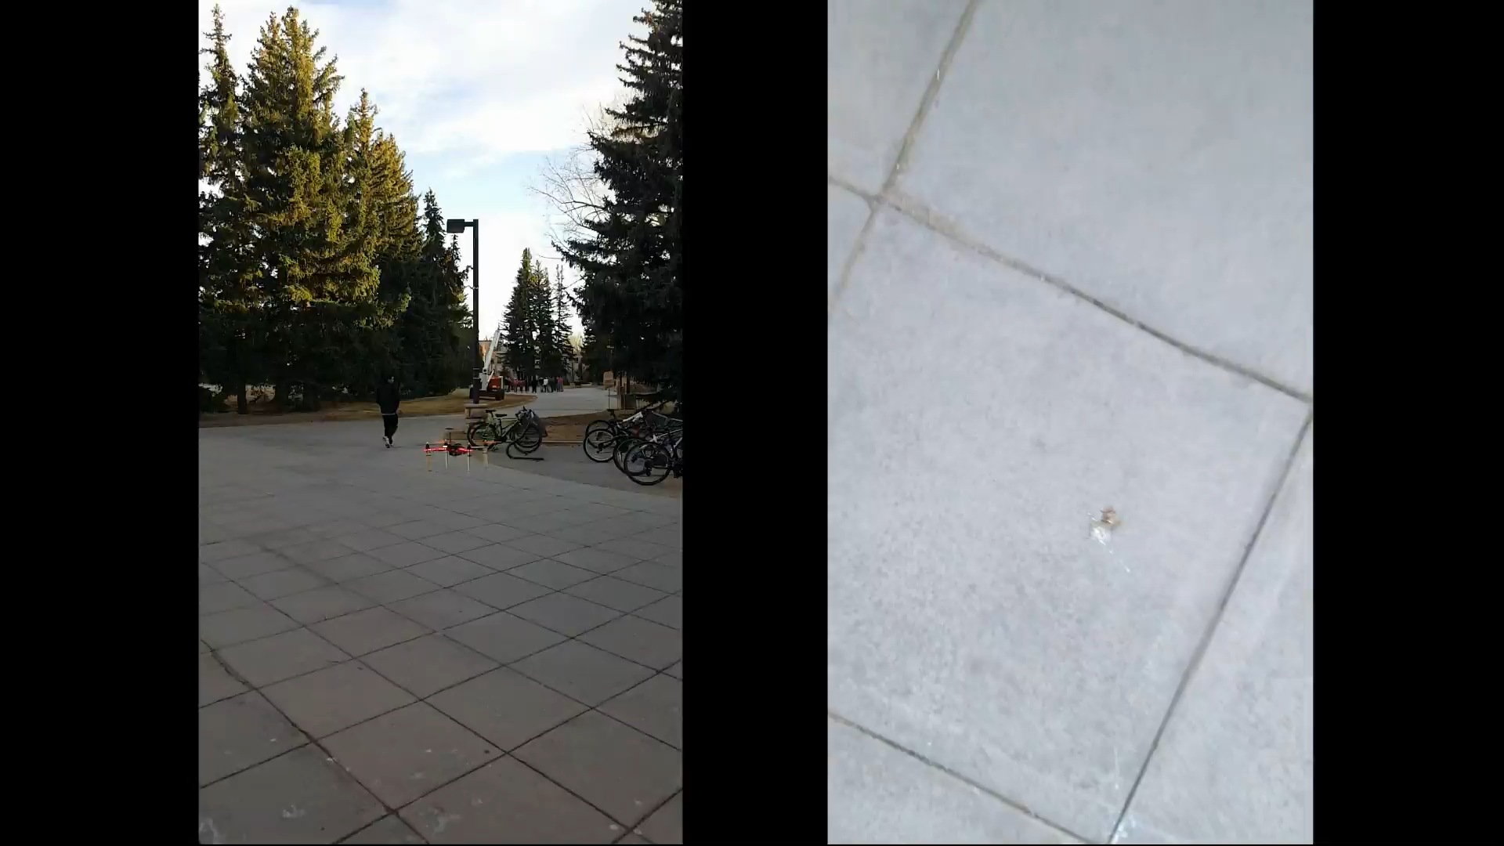
Notes:
Sam preload the video with talking
Learned for each failure
First video talk about lack of sonar
Talk about fail safes
We got it to land

Slide 3
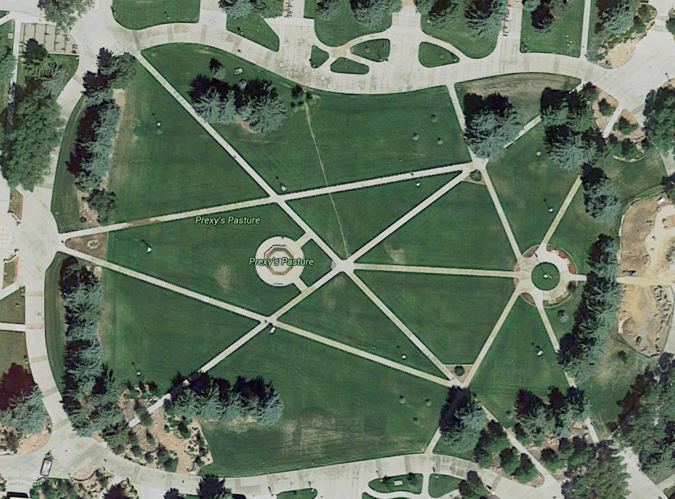
The Problem
Google Maps provides users with satellite images. That is great, but the images are update infrequently and low resolution
Notes:
Sam talking
This is the closest we can zoom into google maps
Infrequently updated
Only taken in summer

Slide 4
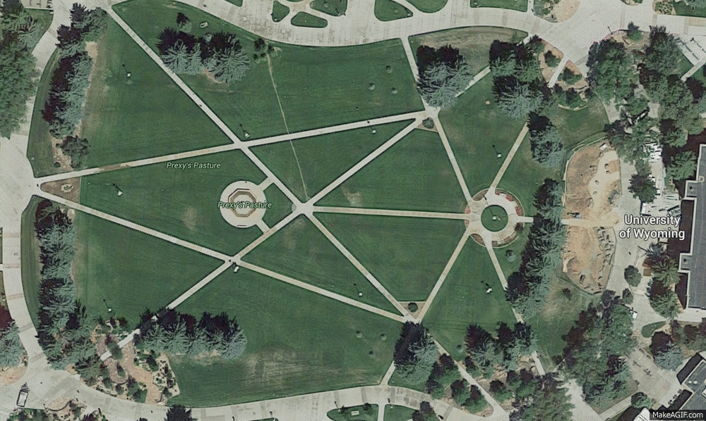
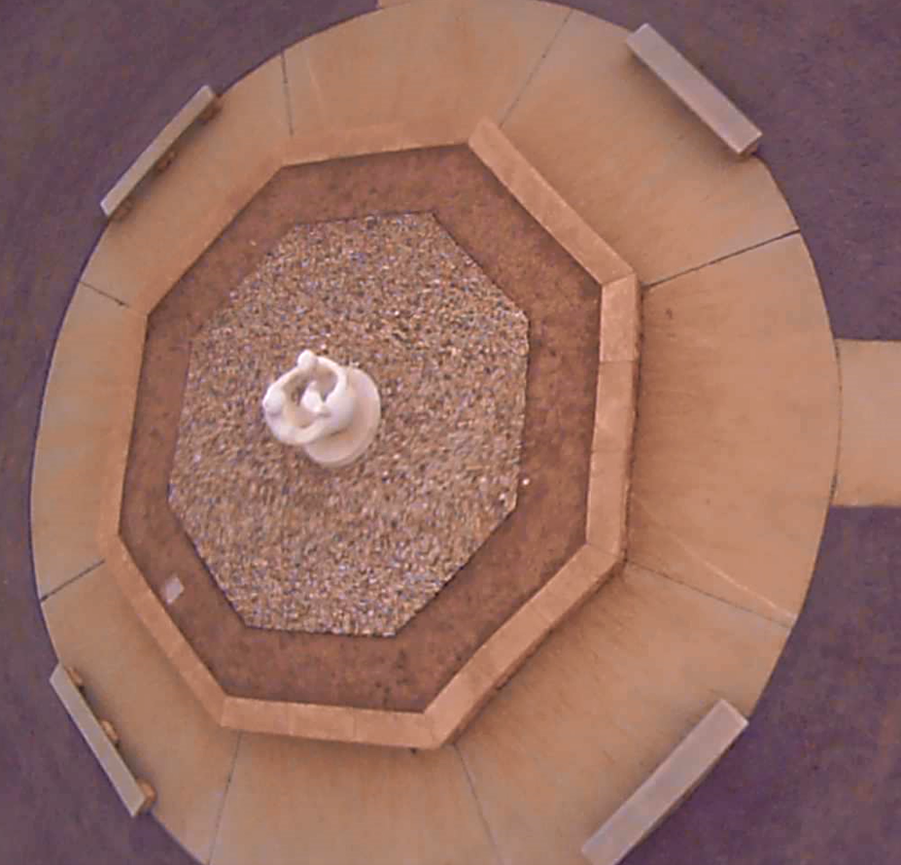
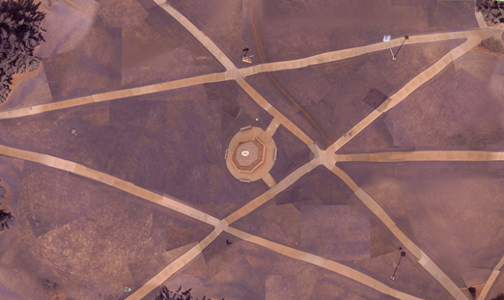
The Solution
Automated Cartography Solutions.
Notes:
Sam talking
Our mapped image
500 images
15min flight time
2000x2000 each image
Zoomed into one image

Slide 5
Potential Uses
Who needs maps updated often?
Open face mines
Construction companies
Farmers
Disaster Reconnaissance
Notes:
Sam talking

Slide 6

What we needed
Open source
Programmable
Payload of ~1lb
GPS functionality
Notes:
Sam talking

Slide 7
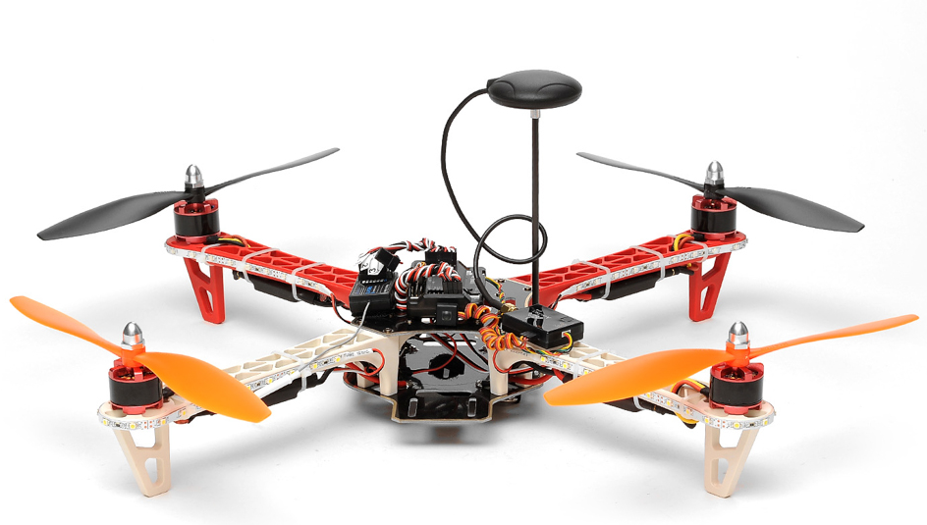
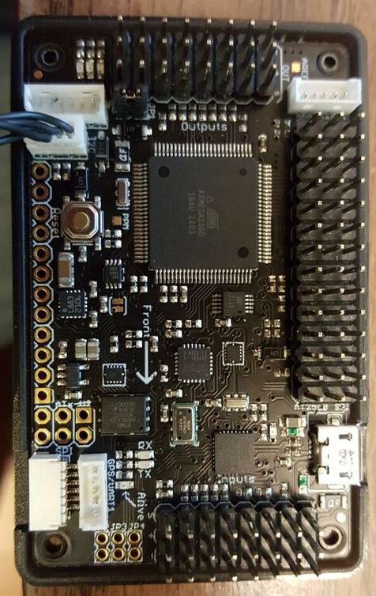
AeroSky P12 Quadcopter
Lipo-Battery
2200 mAh ~ 20 minutes flight time
APM 2.5 Arduino board
Open source and programmable
U-blox NEO-6M GPS module
Accuracy 3 – 5ft
2lb Payload
Notes:
Sam talking
Accuracy:
Position 2.5 m CEP
SBAS 2.0 m CEP
7

Slide 8
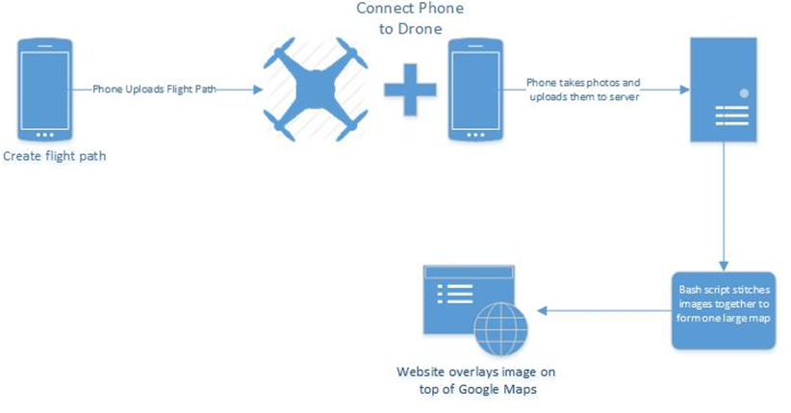
Project Overview
Notes:
Jake talking

Slide 9
Drone and Phone
USB OTG adapter
USB host mode
NEED PHOTO
Notes:
Jake talking

Slide 10
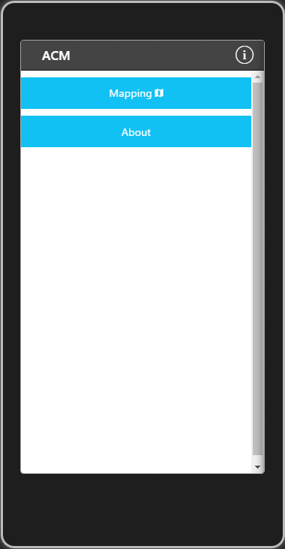
ACS App – Home
Notes:
Jake talking

Slide 11
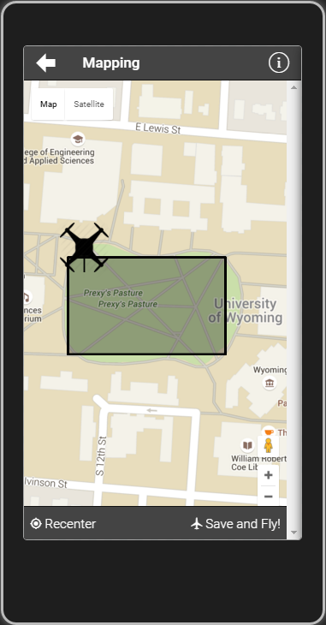
ACS App – Settings
Notes:
Jake talking

Slide 12
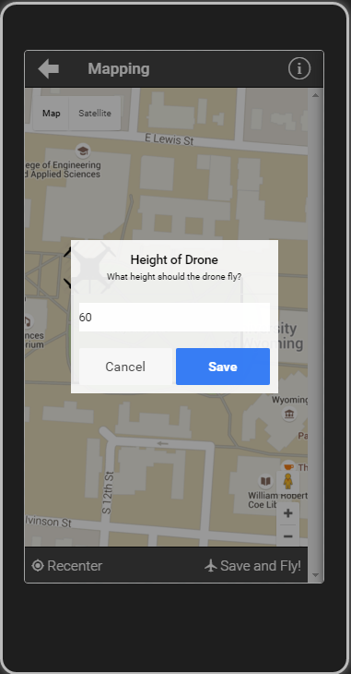
ACS App – Map
Notes:
Jake talking

Slide 13
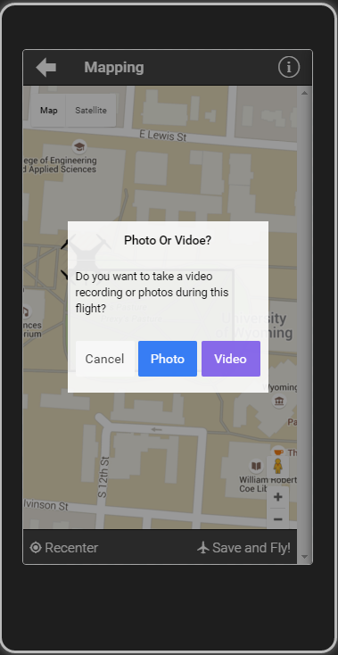
ACS App – Map
Notes:
Jake talking

Slide 14
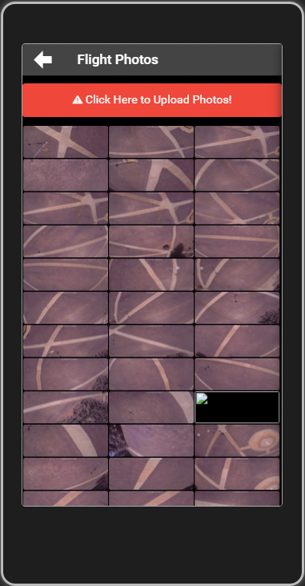
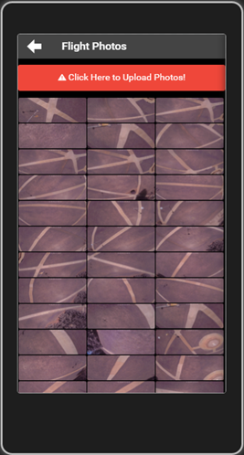
ACS App – Pictures
Notes:
Jake talking

Slide 15
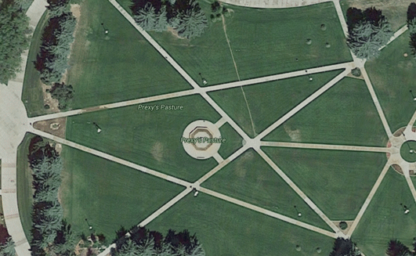
The Result
Notes:
Jake talking

Slide 16
App Overview
Cross Platform app utilizing:
AngularJS (1.4)
Apache Cordova (3.5.1)
Ionic(1.2.4)
jQuery
Creates flight path
Takes photo/videos
Upload photos/videos to the server
Notes:
Jake talking

Slide 17
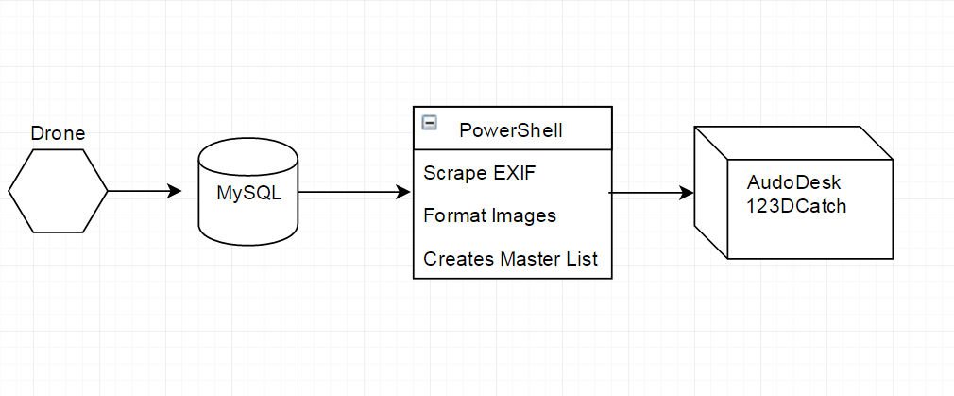
Server Infrastructure Overview
Notes:
Scotty Talking

Slide 18
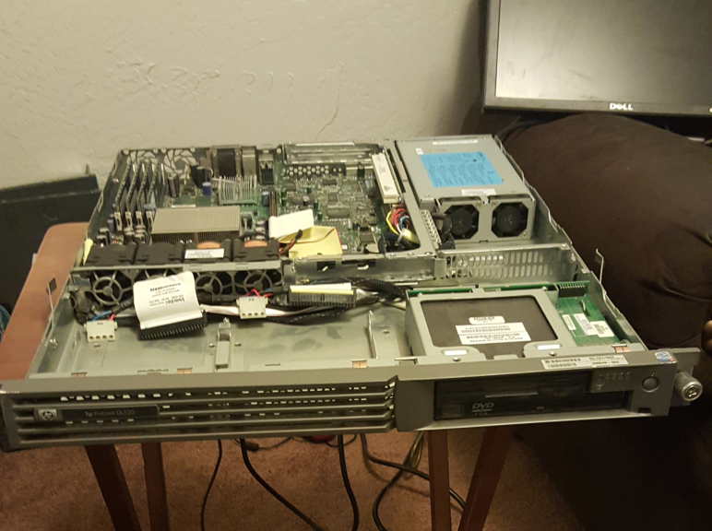
Primary Database Server
Running Windows Server 2012
Uses MySQL
Meta Data
Image Locations
Originally several bash scripts
HP ProLiant DL320
Notes:
Scotty Talking

Slide 19
Server Side Code
Formats images to a uniform size
Scrapes image metadata
Enforces image naming conventions
Creates a master image list
Passes images to Autodesk 123D Catch
Notes:
Scotty Talking

Slide 20

Autodesk 123D Catch
Creates 3D objects using a large set of images
Originally we created a system using ImageMagick and Javascript
Now we record video with the phone and scrape images from it using VLC Player
Notes:
Scotty Talking

Slide 21
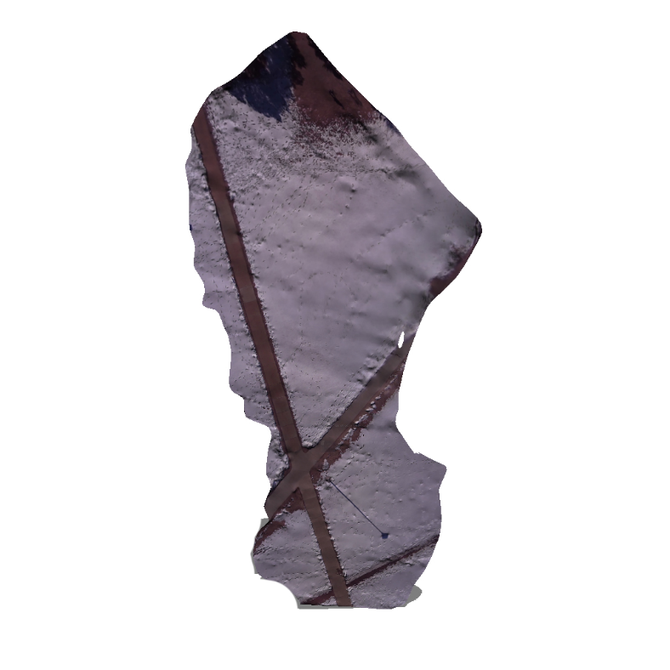
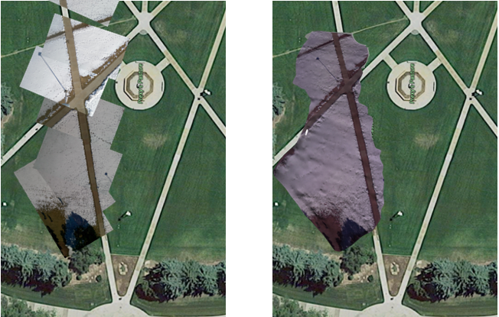
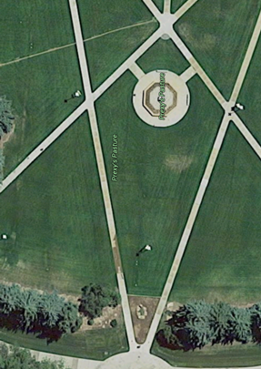
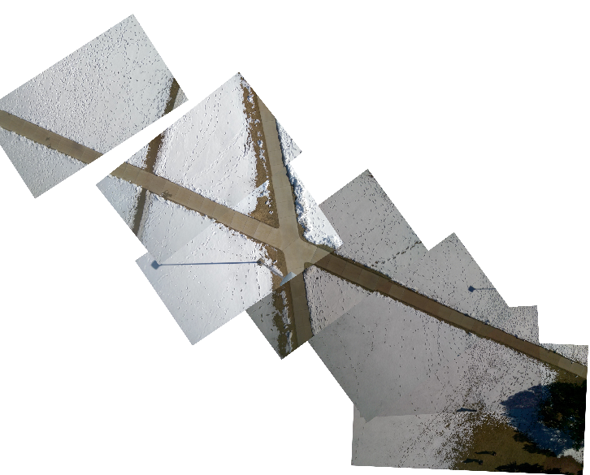
Original map
Autodesk Render
Notes:
Scotty Talking

Slide 22
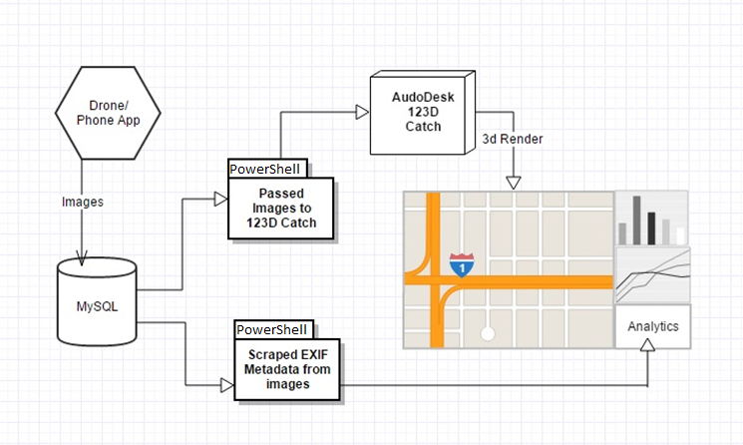
Website Implications
Notes:
Scotty Talking

Slide 23
Analytical Information
Average speed
Estimated distance between images
GPS information
EXIF data from picture
Notes:
Scotty Talking
23

Slide 24
Reporting Tools
Add Website
Maybe just a ton of logs from Mission Planner
Notes:
Scotty Talking

Slide 25
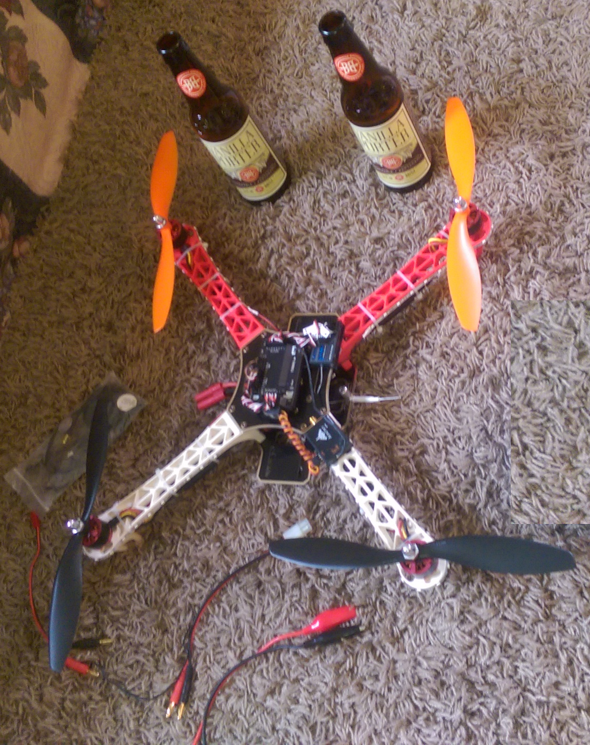
Overview
Open Source
Low initial cost
Hobbyists FFA compliment
Easy to use
Well documented
Notes:
Sam talking

Slide 26
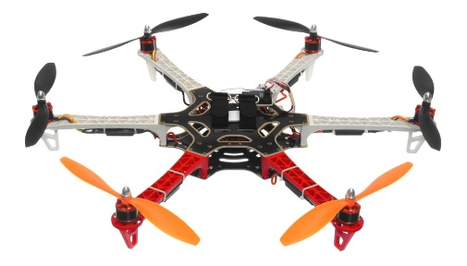
Future Improvements
Low cost hardware upgrades
Sonar
Hexa-Copter
Automatically generated reports
Camera stabilizing mount
Real time video rendering
Notes:
Sam talking

Slide 27
Q
A
&
Notes:
Sam talking
27

